Slide 1

Discrete Probability Distributions
Chapter 6

Slide 2
Benford’s Law – An Example Distribution
The IRS uses Benford’s Law to detect fraudulent tax returns. They observe the first digits of the amounts claimed as deductions and compare those relative frequencies to the theoretical distribution.
Large discrepancies suggest fraud has been committed. Benford’s Law is one example of a probability distribution, a table or graph that pairs each possible value of a random variable with its respective probability.
First-Digit Law: Discrete Probability Distribution
Digit | 1 | 2 | 3 | 4 | 5 | 6 | 7 | 8 | 9
Probability | 0.301 | 0.176 | 0.125 | 0.097 | 0.079 | 0.067 | 0.058 | 0.051 | 0.046

Slide 3
Random Variables
A random variable is a numerical outcome of a probability experiment. Random variables can either be discrete or continuous.
Practice: Determine whether each variable below is a discrete random variable (DRV) or a continuous random variable (CRV).
The distance a KSU employee must commute for work.
The result of a d20 die roll in a game of D&D.
The number of customers who order the newest menu item at the Marietta Diner.
The proportion of lab rats who recovered from illness ABC using medication XYZ.
The speed of a commercial jet.
*Remember: if you have trouble determining these types of problems, try and list the possible values of the random variable.

Slide 4
Probability Distribution
A probability distribution is a table or a histogram that maps each possible outcome of the random variable to its probability. The random variable is represented by a capital letter.
For example, we flip a fair coin twice. Let X be the number of Heads we observe.
Sample Space for Flipping a Coin Twice
1st Toss | 2nd Toss | X = Number of Heads | Probability
H | H | 2 | P(HH) = 0.5*0.5 = 0.25
H | T | 1 | P(HT) = 0.5*0.5 = 0.25
T | H | 1 | P(TH) = 0.5*0.5 = 0.25
T | T | 0 | P(TT) = 0.5*0.5 = 0.25
Let X = Number of Heads in Two Coin Flips
X | 0 | 1 | 2
P(X) | 0.25 | 0.5 | 0.25

Slide 5
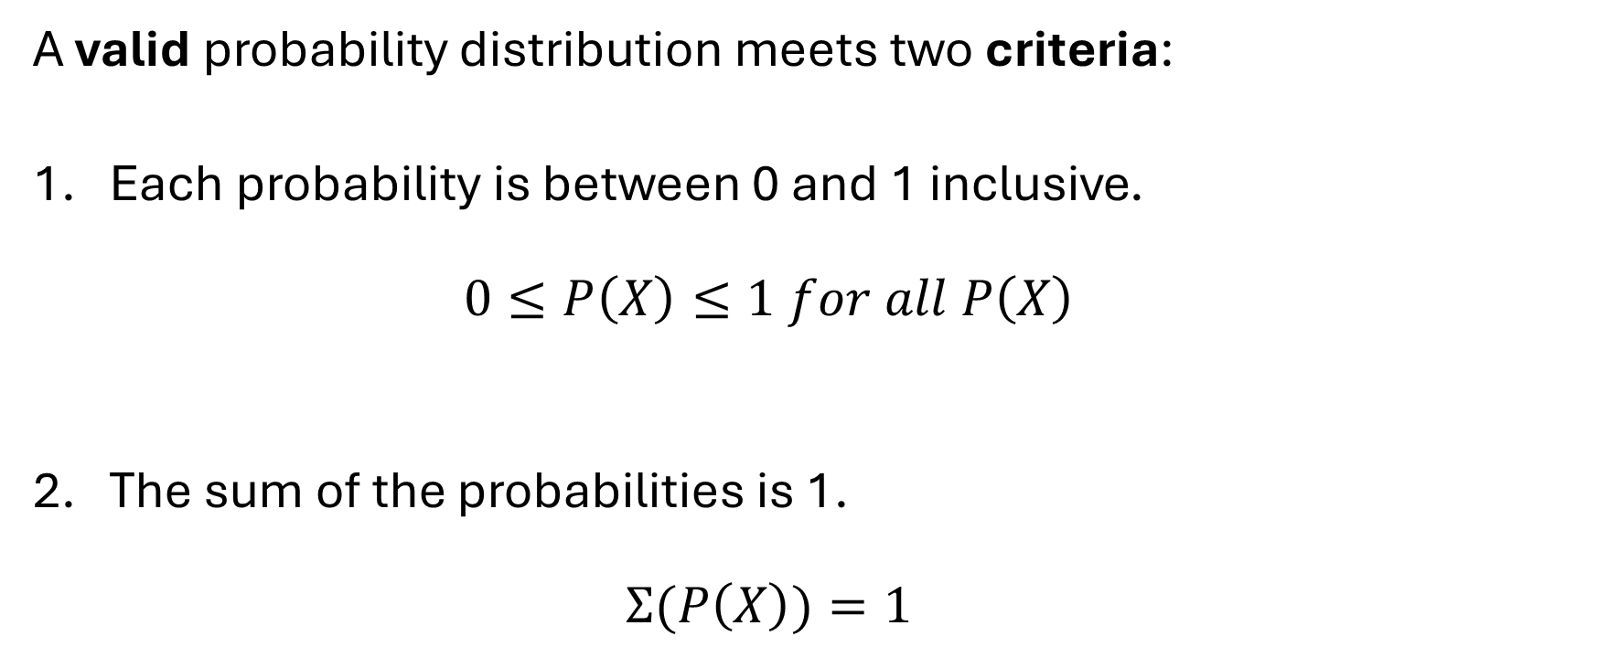
Criteria for Probability Distributions
A valid probability distribution meets two criteria:
Each probability is between 0 and 1 inclusive.
$0≤P\left(X\right)≤1 for all P\left(X\right)$
The sum of the probabilities is 1.
$Σ(P\left(X\right))=1$

Slide 6
Calculating Probabilities
The following discrete probability distribution displays the number of menu items ordered by customers at Gigi’s Café. Calculate the probabilities below.
What is the probability that a customer will order…
Exactly one item?
Two or three items?
More than two items?
At least four items?
Fewer than six items?
At most three items?
Between two and four items inclusive?
At least three but fewer than six items?
Number of Menu Items Ordered at Gigi's Cafe
X | 1 | 2 | 3 | 4 | 5 | 6
P(X) | 0.323 | 0.406 | 0.112 | 0.045 | 0.098 | 0.016

Slide 7
Describing a Population
A probability distribution describes a population.
Suppose we tally the number of courses each undergraduate student is taking at a local college. Out of 5,000 undergraduates, 478 are taking one class, 645 are taking two classes, 568 are taking three classes, 1864 are taking four classes, 1357 are taking five classes, and 88 are taking six classes. Let X represent the number of classes taken by a randomly selected student at this college. It’s reasonable for the college administration to use this data to describe and predict the patterns of student behavior.
Create a probability distribution as both a table and as a histogram using R.
What is the mode of the distribution?
What is the probability that a randomly selected student will be taking exactly three classes?
… at least four classes?
… three or fewer classes?

Slide 8
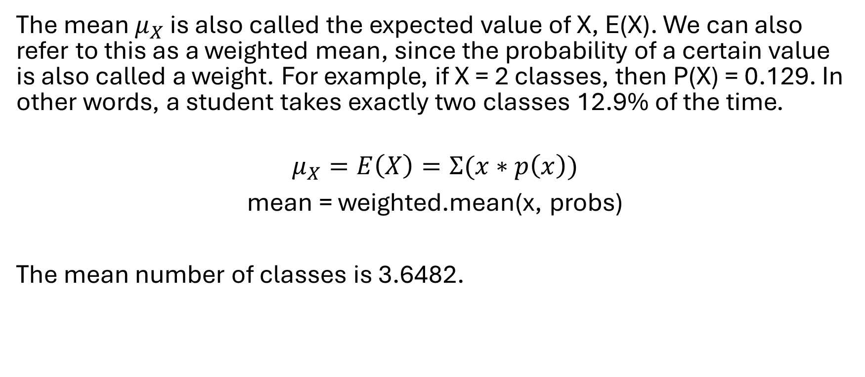
The Mean of a Discrete Random Variable
The mean $μ_{X}$ is also called the expected value of X, E(X). We can also refer to this as a weighted mean, since the probability of a certain value is also called a weight. For example, if X = 2 classes, then P(X) = 0.129. In other words, a student takes exactly two classes 12.9% of the time.
$$μ_{X}=E\left(X\right)=Σ(x∗p\left(x\right))$$
mean = weighted.mean(x, probs)
The mean number of classes is 3.6482.

Slide 9
The Law of Large Numbers for Means
For a large sample, the sample mean will be very close to the population mean. The larger the sample, the closer the sample mean will approach the population mean.
To interpret the mean of the example above: if we were to take a very large sample of undergraduate students from this college, we would expect the mean number of classes they are taking to be very close to 3.6. Since this represents a discrete random variable, in practical terms, we expect most students to take between 3 and 4 classes (more likely 4).
When asked to give the mean of a DRV, provide the calculated decimal value. Remember, the mean of a discrete value does not have to be a whole number.

Slide 10
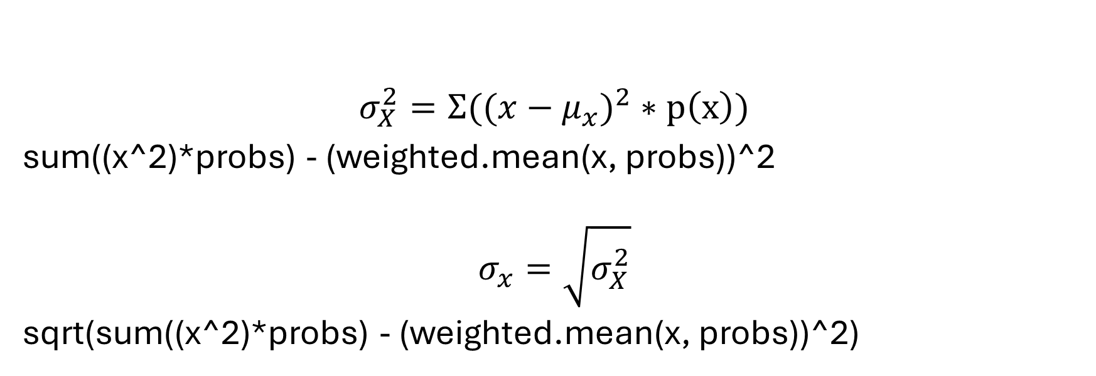
The Variance and Standard Deviation of a Discrete Random Variable
$$σ_{X}^{2}=Σ(({x−μ_{x})}^{2}∗p\left(x\right))$$
sum((x^2)*probs) - (weighted.mean(x, probs))^2
$$σ_{x}=\sqrt{σ_{X}^{2}}$$
sqrt(sum((x^2)*probs) - (weighted.mean(x, probs))^2)

Slide 11
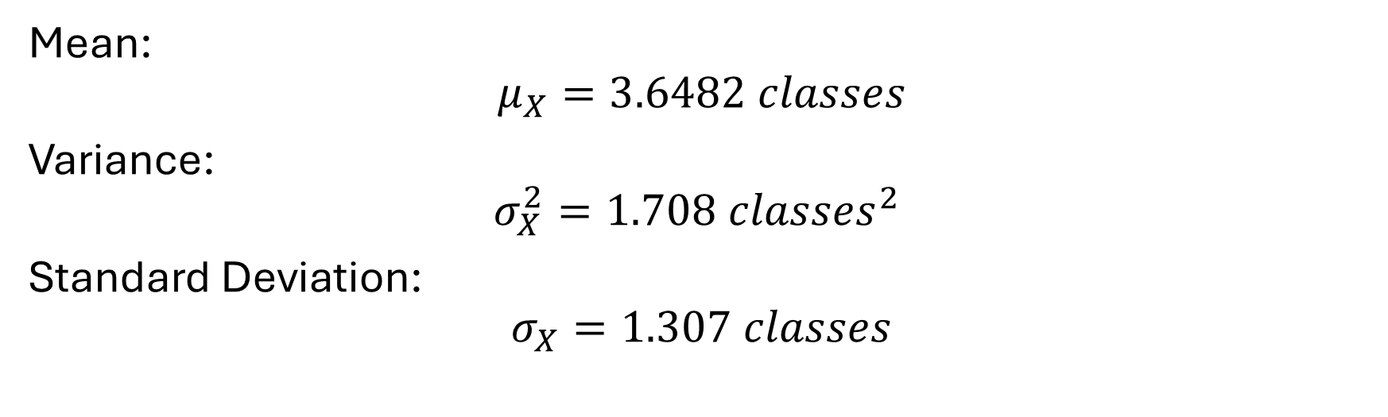
Parameters of the Discrete Distribution of Classes
Mean:
$$μ_{X}=3.6482 classes$$
Variance:
$$σ_{X}^{2}=1.708 {classes}^{2}$$
Standard Deviation:
$$σ_{X}=1.307 classes$$

Slide 12
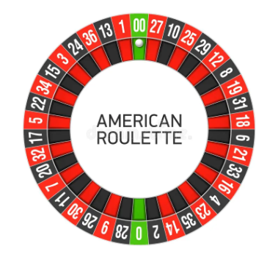
Example: Roulette Wheel
A roulette wheel (in a casino) has 38 pockets: 18 are red, 18 are black, and 2 are green. If you bet a dollar on red, spin the wheel, and it lands on red, you win back your dollar plus another dollar. If the wheel lands on black or green, you lose a dollar.
Bet $1 = -$1 (“winning” a negative dollar is how we say losing a dollar)
Let X be the amount of money you win. Find the mean, variance, and standard deviation of this discrete distribution.

Slide 13
Example: Mining Business
The potential profits/losses of a particular mining venture are listed below, along with the associated probabilities stated by a mineral economist.
$30 million loss 0.4
$20 million profit 0.5
$40 million profit 0.1
What is the expected gain (or loss) of this business venture? Find the mean, variance, and standard deviation.

Slide 14
The Binomial Distribution
Wendy’s is giving away a scratch-off coupon with the purchase of every meal for a chance to win a free ice cream. 20% of the coupons are winners, and the rest say, “better luck next time!” You and nine other friends go out to Wendy’s for lunch… What is the probability that exactly three of you will win an ice cream?
These coupons are binomial random variables because they consist of exactly two possible outcomes: win or lose. Any random variable that meets the following criteria are considered binomial random variables.

Slide 15
Conditions for the Binomial Distribution
There is a fixed number of trials, n.
There are two possible outcomes per trial: a success and a failure. [a note on vocabulary]
The probability of success – P(S) – is always the same.
Each trial is independent.
X represents the number of successes.
n = number of trials
p = probability of success
1 - p = probability of failure

Slide 16
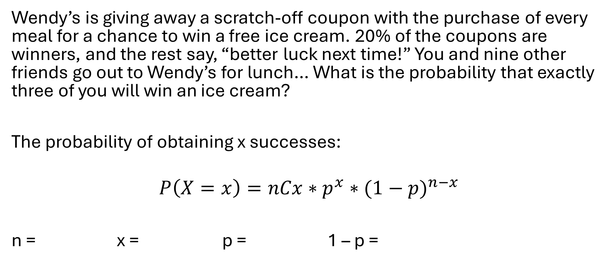
Calculating Binomial Probabilities
Wendy’s is giving away a scratch-off coupon with the purchase of every meal for a chance to win a free ice cream. 20% of the coupons are winners, and the rest say, “better luck next time!” You and nine other friends go out to Wendy’s for lunch… What is the probability that exactly three of you will win an ice cream?
The probability of obtaining x successes:
$$P\left(X=x\right)=nCx∗p^{x}∗{(1−p)}^{n−x}$$
n = x = p = 1 – p =

Slide 17
Binomials Using R
P(X=x) = dbinom(x, n, p)
P(X=3) = dbinom(3, 10, 0.2) = 0.2013
If the probability of success is 0.20, and exactly ten people purchase a meal, then the probability that exactly three people win a free ice cream is 0.2013.

Slide 18
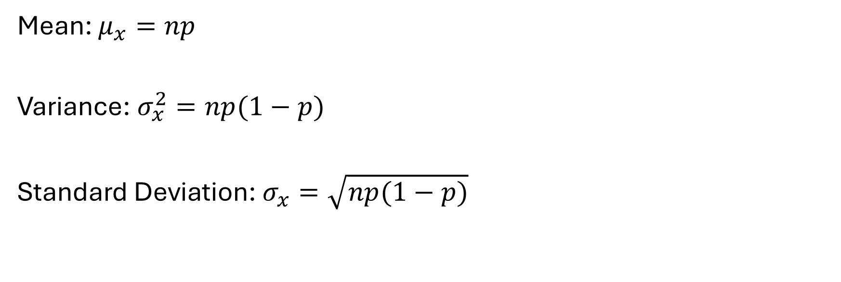
The Mean, Variance, and Standard Deviation of a Binomial Random Variable
Mean: $μ_{x}=np$
Variance: $σ_{x}^{2}=np(1−p)$
Standard Deviation: $σ_{x}=\sqrt{np(1−p)}$

Slide 19
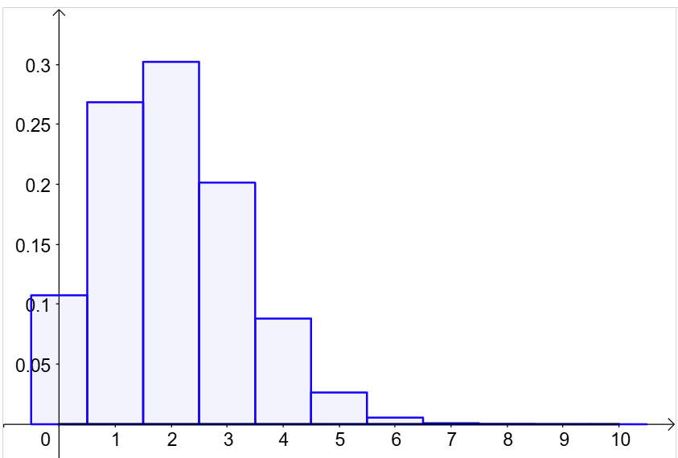
Back to the Ice Cream Example
Mean = 10*0.2 = 2 winners
Variance = 10*0.2*0.8 = 1.6 winners^2
Standard deviation = sqrt(10*0.2*0.8) = 1.26 winners

Slide 20
Cumulative Binomial Probabilities
P(X≤x) = pbinom(x, n, p)
Example: In a recent poll, 50% of adults said that they play video games. Let’s say 9 adults are randomly selected and asked the same question. Compute the following probabilities:
That exactly 4 play video games.
Fewer than 3 play video games.
More than 3 play video games.
At least 7 play video games.
Between 4 and 6 inclusive play video games.
What is the mean or expected value?

Slide 21
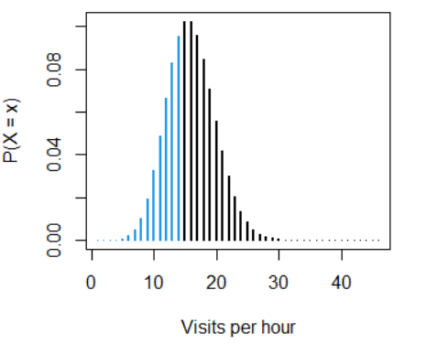
The Poisson Distribution
The number of events that happen in a particular interval of time or space.
Some example predictions include:
Text messages per hour
Male grizzly bears per square mile
Machine malfunctions per year
Website visitors per month
Influenza cases per year

Slide 22
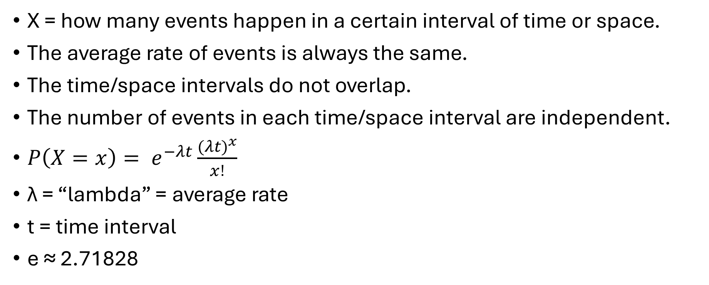
Criteria for the Poisson Distribution
X = how many events happen in a certain interval of time or space.
The average rate of events is always the same.
The time/space intervals do not overlap.
The number of events in each time/space interval are independent.
$P\left(X=x\right)= e^{−λt}\frac{{(λt)}^{x}}{x!}$
λ = “lambda” = average rate
t = time interval
e ≈ 2.71828

Slide 23
Using R
P(X=x) = dpois(x, lambda)
P(X≤x) = ppois(x, lambda)

Slide 24
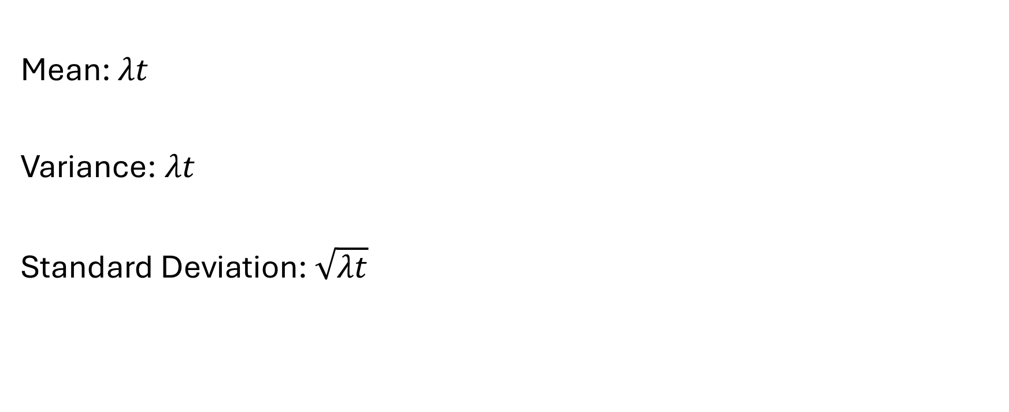
Mean, Variance, and Standard Deviation of a Poisson Random Variable
Mean: $λt$
Variance: $λt$
Standard Deviation: $\sqrt{λt}$

Slide 25
Website Example
The Acme Corporation website receives visits that follow a Poisson distribution with 𝜆 = 25 per minute. Let X = the number of visits that occur in half a minute.
What is the probability that X=15 (that the site will receive exactly 15 visits in a 30-second window)?
What is the probability that it will receive at most 10 visits?
What is the probability that it will receive more than 20 visits?

Slide 26
Water Example
We are counting the number of bacteria in local wastewater. The amount follows a Poisson distribution of 𝜆= 4 per microliter.
If we draw 5 microliters, what is the probability that we will count exactly 10 bacteria?
If we draw 5 microliters, what is the probability that we will count fewer than 30 bacteria?
If we draw 5 microliters, what is the probability that we will count at least 20 bacteria?
What are the mean and standard deviation of the Poisson random variable?

